Slide 1

IBM/Coursera Data Science Capstone Project

Slide 2
Finding a location in Seattle for outdoor movie showings is valuable for movie theaters to sustain business and maintain viewership post-COVID-19
Background:
Box office revenues have declined from ~10.3B in 2019 to $2B in 2020 due to COVID-19 (boxofficemojo.com)
Ongoing shift towards online streaming over the past decade to platforms such as Netflix and Hulu
Goals:
Better understand customer segmentation in Seattle based on venues around the city.
Find a location recommendation to implement and test these new outdoor business models in 2021.

Slide 3
Data Acquisition and Data Wrangling
List of neighborhoods in Seattle from https://www.seattle.gov/neighborhoods/neighborhoods-and-districts)
Approximate latitude, longitude coordinates for neighborhood centers found using the geopy library
Frequency and type of venues (including theaters and non-theaters) in each neighborhood from Foursquare API location data
Cleaned data contains 43 neighborhoods, 2293 venues, and 310 unique venue categories

Slide 4
Seattle Neighborhoods
Neighborhood locations on Folium Map
Seattle Center coordinates: 47.6038321, -122.3300624

Slide 5
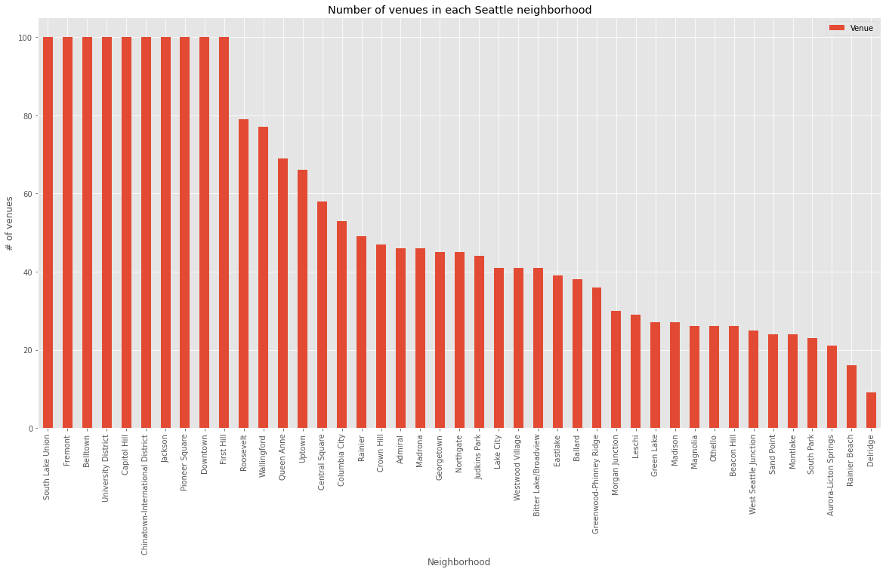
Number of Neighborhood Venues
Neighborhoods ranged from ~10 to 100 within 800 meter radius
23% high density neighborhoods w/100 venues

Slide 6
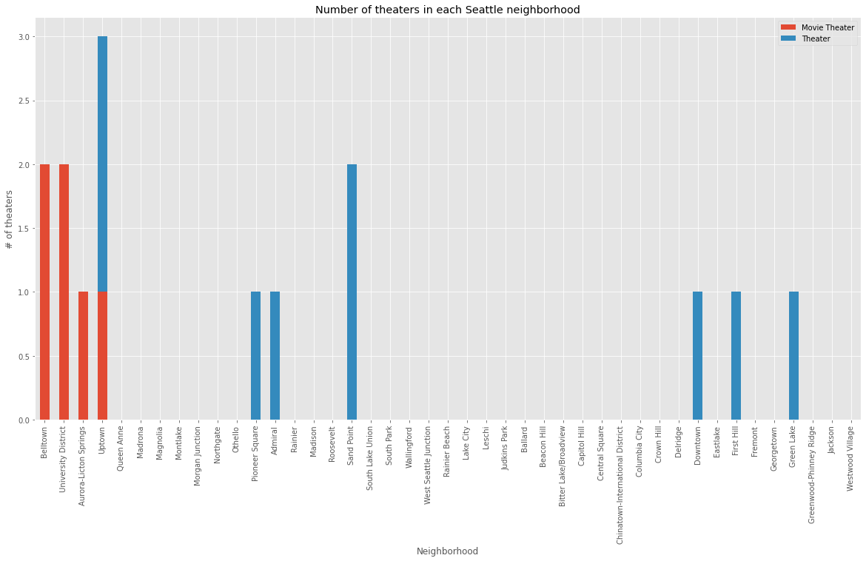
Movie Theaters and Other Theaters in Neighborhoods
10 Neighborhoods have venues that are direct (or somewhat direct) competitors to the movie theater company
Avoid these neighborhoods as location recommendations

Slide 7
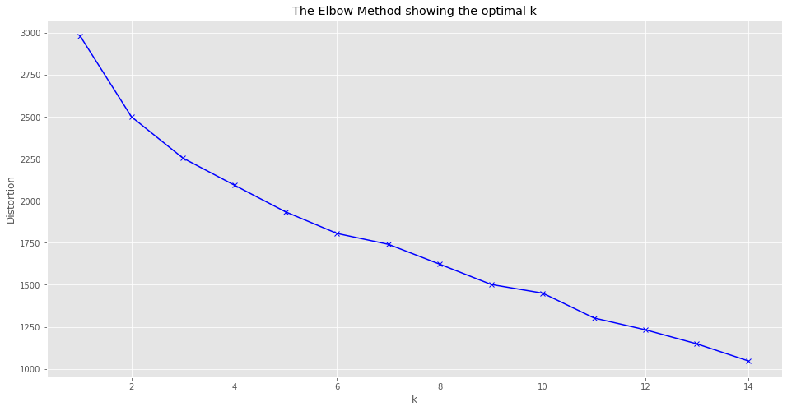
KMeans Clustering – Elbow Method
No clear optimal elbow point
Manual testing used to determine number of clusters, k=11

Slide 8
Neighborhood Clusters + Folium Map K=11

Slide 9
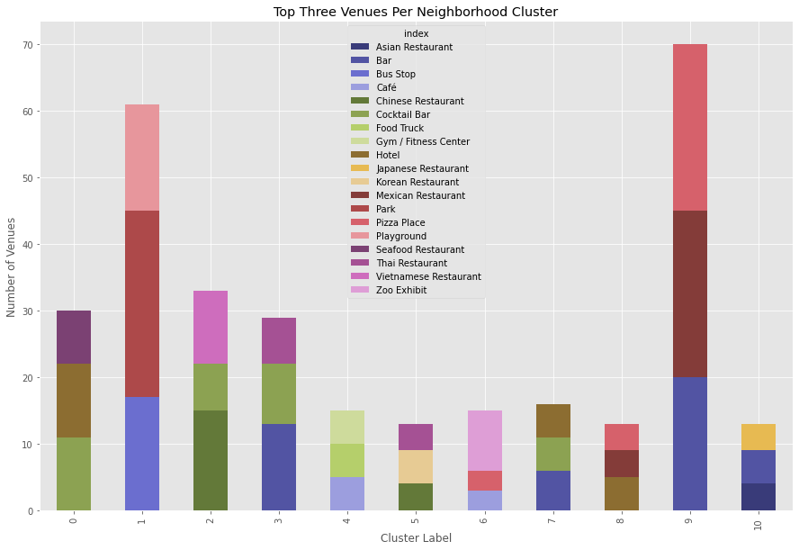
Kmeans – Neighborhood Clusters
Cluster Categorizations*:
0: Accommodations and Food
1: Outdoor Recreation and Transportation
2: Asian Restaurants and Bars
3: Bars and Asian Restaurants
4: Cafes and Gyms
5: Asian Restaurants
6: Zoos and Parks
7: Accommodations and Bars
8: Accommodations and General Dining
9: Bars and General Dining
10: Bars and Asian Restaurants
*Note: Several categories are similar, e.g. Bars and Asian Restaurants. The distinction is usually the type of Asian restaurant, e.g. Thai, Chinese, etc. However for simplicity, I have categorized them together as 'Asian restaurants'.

Slide 10
Excluded Neighborhoods
Neighborhoods containing theaters removed from the “short-list” of possible location candidates ->
Neighborhoods containing movie theaters (a different venue category) also were excluded:
Belltown
University District
Aurora-Licton Springs
Uptown

Slide 11
Create a Location Short-List
Focus on clusters with access to transportation and/or outdoor areas: clusters 1 and 6
Easy accessibility
Space to host socially distanced outdoor viewings
Short-listed location candidates (partial view) ->

Slide 12
Venue Density Heat Map + Short-Listed Neighborhoods
RECOMMENDATIONS
Location: Magnolia, Westwood Village, and Bitterlake/Broadview (all in Cluster 1) as potential locations for the movie theater company to create outdoor showing/drive-in theater experiences.
Near transportation -> easily accessible to Seattleites and tourists
Plenty of outdoor areas and open space needed to implement new outdoor movie business model in 2021
Content: A large portion of venues are dedicated to travel accommodations, outdoors, and Asian restaurants, therefore it is recommended that movie content chosen focus on multicultural, action-adventure type of programming for Seattle viewers

Slide 13
Conclusion and Future Analysis
Found several viable candidates for a location in Seattle to test outdoor screenings/drive-in movies for the movie theater company
Further research is needed on customer segmentation, e.g.:
Population demographics data
Compare Seattle with other similar cities such as Portland or Vancouver to better understand the distinct viewing audience in Seattle (if any)
Movie theater companies can use this type of data analysis in other cities to:
Identify locations for outdoor viewing experiences for their audiences
Help identify new/updated movie theater business models and locations

